Slide 1
Shangquan Sun, Runyu Zheng
JANUS: Fast and Flexible Deep Learning via Symbolic Graph Execution of Imperative Programs
TASO: Optimizing Deep Learning Computation with Automatic Generation of Graph Substitutions
Eunji Jeong, Sungwoo Cho, Gyeong-In Yu, Joo Seong Jeong, Dong-Jin Shin, Byung-Gon Chun
Zhihao Jia, Oded Padon, James Thomas, Todd Warszawski, Matei Zaharia, Alex Aiken

Slide 2
JANUS: Fast and Flexible Deep Learning via Symbolic Graph Execution of Imperative Programs

Slide 3
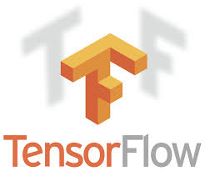
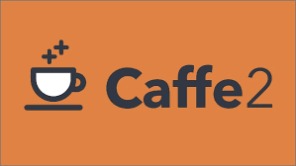




2 distinct families of DL frameworks
Symbolic graph execution, e.g.
Tensorflow
Caffe2
MXNet
Imperative program execution, e.g.
PyTorch
Tensorflow Eager
MXNet Imperative

Slide 4
Symbolic graph execution
Pros:
Ease of optimization
Ease of parallelization
Ease of compiler optimization, e.g. subexpression elimination, constant folding
Ease of processing on accelerator devices or deploying on multiple machines
Cons:
Complication of user experience

Slide 5
Imperative program execution
Pros:
Ease of rapidly implementing and working with new NN models
Cons:
Less chance of optimization, leading to lower performance

Slide 6
Problem and Importance
Problem:
How to transparently convert imperative Python DL programs into symbolic dataflow graphs before execution?
Importance:
Adopt all Pros of both symbolic graphs and imperative programs
Drop all Cons of both symbolic graphs and imperative programs
Notes:
And the importance of such conversion is that we can adopt all pros...

Slide 7
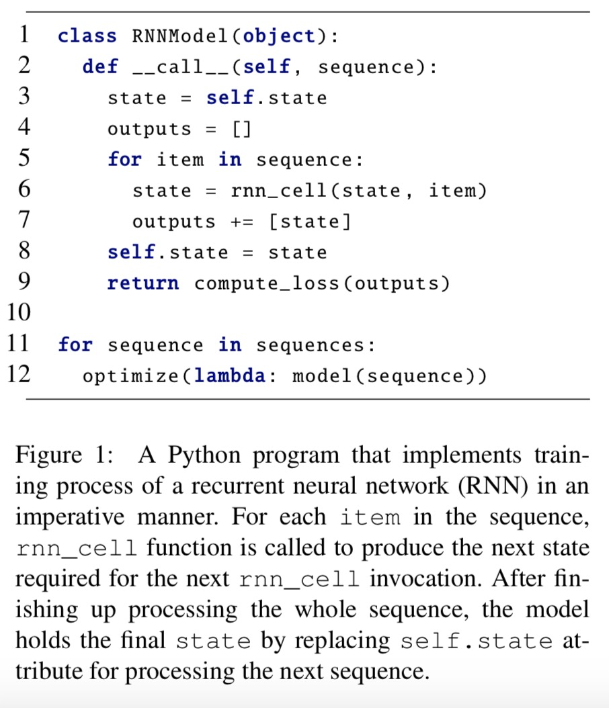
Challenges
Dataflow graphs consist of a restrictive set of operations, lacking the dynamic semantics of the programming language
Hard to capture dynamic semantics of an imperative DL program correctly:
dynamic control flow (DCF), e.g. for/while/if
dynamic types (DT), e.g. list/int/float
impure functions (IF), e.g. __call__/self
Notes:
Converting an imperative program written in Python into a DL dataflow graph brings on many challenges, because...
And it’s hard to …
Here is an example of python RNN program. We can see all three dynamic semantics are used in the codes. For instance, the for loop in red circle is a dynamic control flow. Such control flow statements are intensively used in Python, makes it a challenge to be correctly represented in the dataflow graph. And the output list in blue circle is a dynamic type. Here the challenge is we cannot explicitly determine the size and content type of the list. Also, the orange circle represents an impure function. It reads from and writes to an object attribute at Lines 3 and 8. Since the modified global states can make the following function call behave differently, such reads and writes of global states must be handled correctly while generating dataflow graphs.

Slide 8
Related works (1)
Tracing-based graph generation approaches
PyTorch’s JIT compiler
MXNet Gluon
defun functionality of TensorFlow Eager
Features:
fail to capture dynamic semantics of the Python interpreter correctly
currently do not give any feedback about incorrectly-converted control flows to users
Notes:
To deal with the problem, there are two types of approaches in previous research. First is Tracing-based graph generation approaches such as … . The problem is that they fail to ...

Slide 9
Related works (2)
Approaches for a less-dynamic host language
JAX (limited Python syntax)
S4TF (Swift)
Features:
lose the merit of supporting Python
Notes:
Second is … . The problem of this approach is that they …

Slide 10
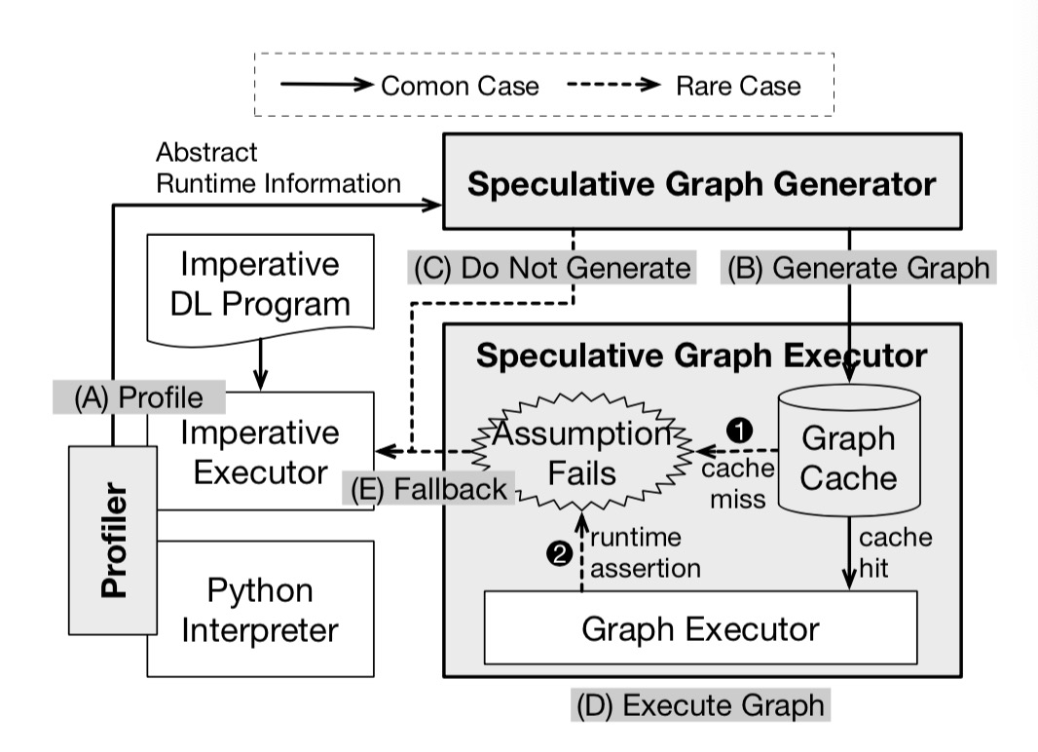
Proposed solution: JANUS
Speculative Graph
Generation and Execution
Runtime profiling
Symbolic graph generation
Graph execution
Notes:
Therefore, the authors of the paper proposed JANUS, which is a method of speculative graph generation and execution. In common cases, it includes three steps: runtime profiling, symbolic graph generation, and graph execution.
Once JANUS receives a DL program, the program is first executed imperatively, while the Profiler gathers abstract runtime information required for making reasonable assumptions. After a sufficient amount of information has been collected, the Speculative Graph Generator tries to convert the program into a symbolic dataflow graph with the assumptions based on the runtime information. Finally, the Speculative Graph Executor executes the symbolic graph

Slide 11
Rare Cases
Assumption failure (1, 2)
Imperatively executed programs (C)
Notes:
However, in some rare cases, JANUS may fail to handle the case.
For example, when an assumption fails, speculative graph executor will raise an assertion, which makes JANUS adopt the fallback and eventually goes back to the imperative executor.
Also for some imperative programs, such as coroutine, it’s impossible to generate a graph and thus can only be executed by imperative executor..

Slide 12
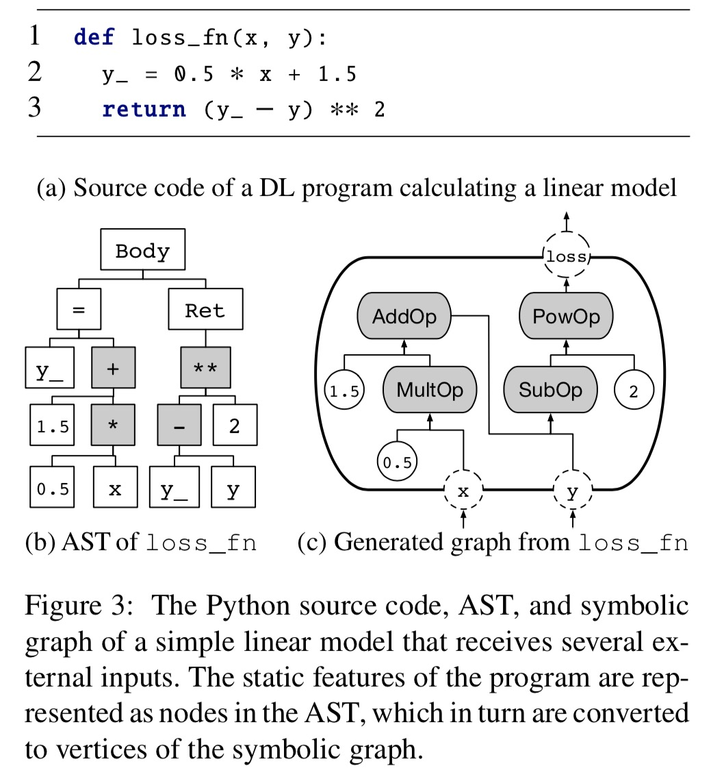
Basic Graph Conversion Process
Figure (a): Imperative Program
Figure (c): Symbolic Graph
Notes:
Let’s go back to common cases. If there is no errors reported, the basic graph conversion process goes like this.
In this example, the imperative program shown in Figure (a) is a simple linear model. And after the conversion process, the final output is a symbolic graph shown in Figure (c). As we can see, the static features of the program are represented as nodes in the AST, which in turn are converted to vertices of the symbolic graph.

Slide 13
Dynamic Features
Dynamic Control Flow
Dynamic Type
Impure Functions
Notes:
As we mentioned before, JANUS deals with the challenges of capturing three kinds of dynamic semantics.

Slide 14
Dynamic Control Flow
if: SwitchOp + MergeOp
while/for: SwitchOp + MergeOp + NextIterationOps
func: InvokeOp
Speculative graph generation: unrolling and inlining
Notes:
First, the if statement, can be obtained by combining switch and merge primitives. In TensorFlow, the SwitchOp and MergeOp serve the two functionalities. Second, the iterative statements of Python, while and for, are handled by using the switch and merge primitives together with loop context primitives that hold iteration frames. Finally, for function calls, a separate graph is generated for the callee function, and a function invocation operation that points to the generated graph is inserted in the position of the function calls.
If JANUS detects that only a single particular path is taken for a certain control flow operation during profiling, JANUS presumes that the control flow decision is actually fixed. The system replaces the control flow operation with an assertion operation that double-checks the assumption for this control flow decision, and proceeds with graph generation as if the control flow operation were unrolled. This allows JANUS to remove control flow operation overheads and apply graph optimizations such as common subexpression elimination or constant folding. If the assertion operation fails, JANUS falls back to imperative execution

Slide 15
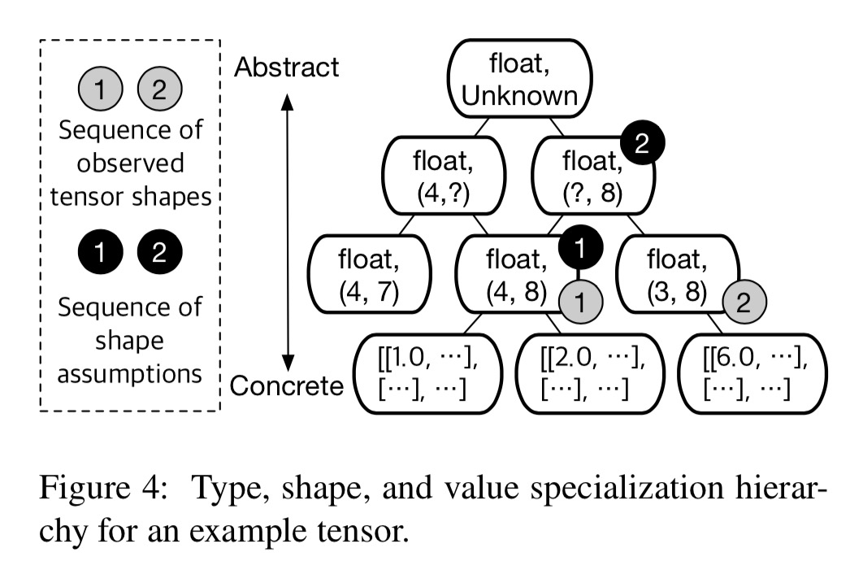
Dynamic Type
Speculative graph generation: specialization
Notes:
When converting imperative programs, we cannot know the type of an arbitrary Python expression before actually executing the expression. But we can infer it given the types of other expression. But some expressions whose types cannot be inferred from other expressions, for example, the types of function inputs or object attribute, require a different measure. To make proper assumptions about the types of such expressions, Profiler observes the types of the expressions during imperative executions.
Also, for some tensor whose size is unknown, the profiler might firstly assume it’s 4 by 8, for example, after running say, 1 iteration. But after running several more iterations imperatively, it is found that its size could be also (3,8), which means the size of the tensor will vary from (4,8) to (3,8). The first dimension is undetermined. In this case, the Profiler will generalize the assumption, which is denoted by (?, 8).

Slide 16
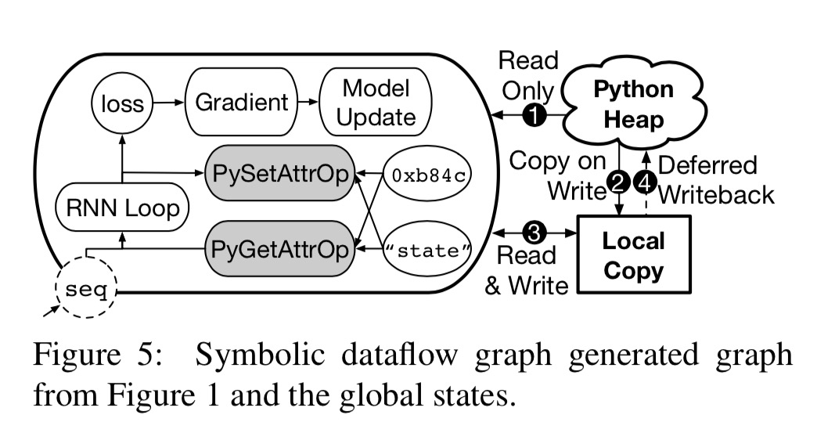
Impure Functions
Optimized graph generation: deferred state update
Notes:
It is common for a Python function to access global variables to calculate return values and have side-effects. Likewise, it is common for a Python DL program to read from and write to global states, such as global and nonlocal variables. JANUS respects this characteristic and handles global state accesses and updates alongside symbolic graph execution. To make things simpler and also faster, JANUS does not mutate globally accessible states in place on the fly. JANUS instead creates local copies of global states, and mutates only the local copies during symbolic graph execution, and updates back to global states after execution.

Slide 17
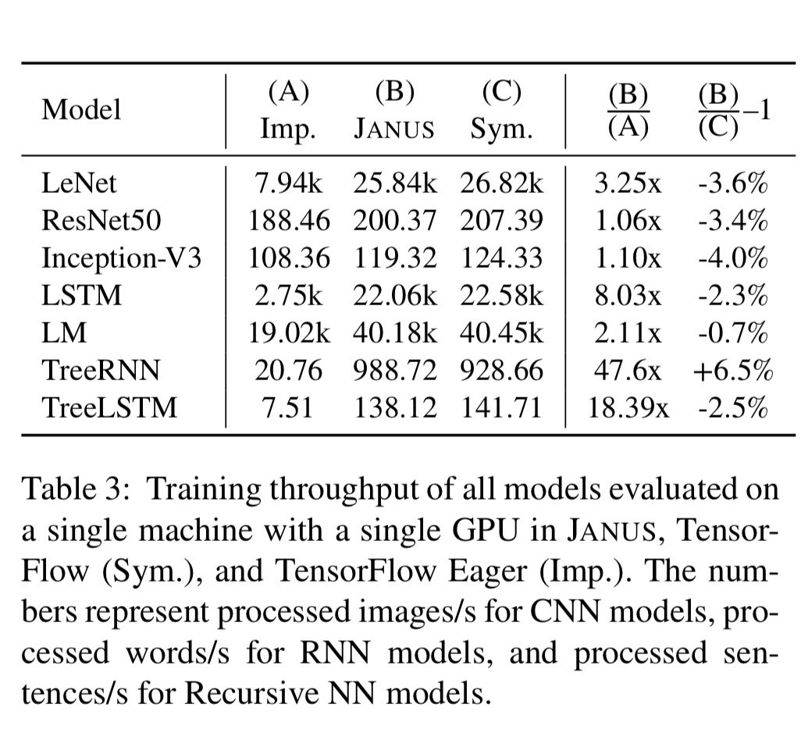
Evaluation
Notes:
Then let’s talk about some evaluation results. From the table, we could see the Symbolic Graph Execution from JANUS are almost as fast as Symbolic graph, which is Tensorflow here. Most JANUS’s results are several times faster than imperative program execution, which is Tensorflow Eager here.

Slide 18
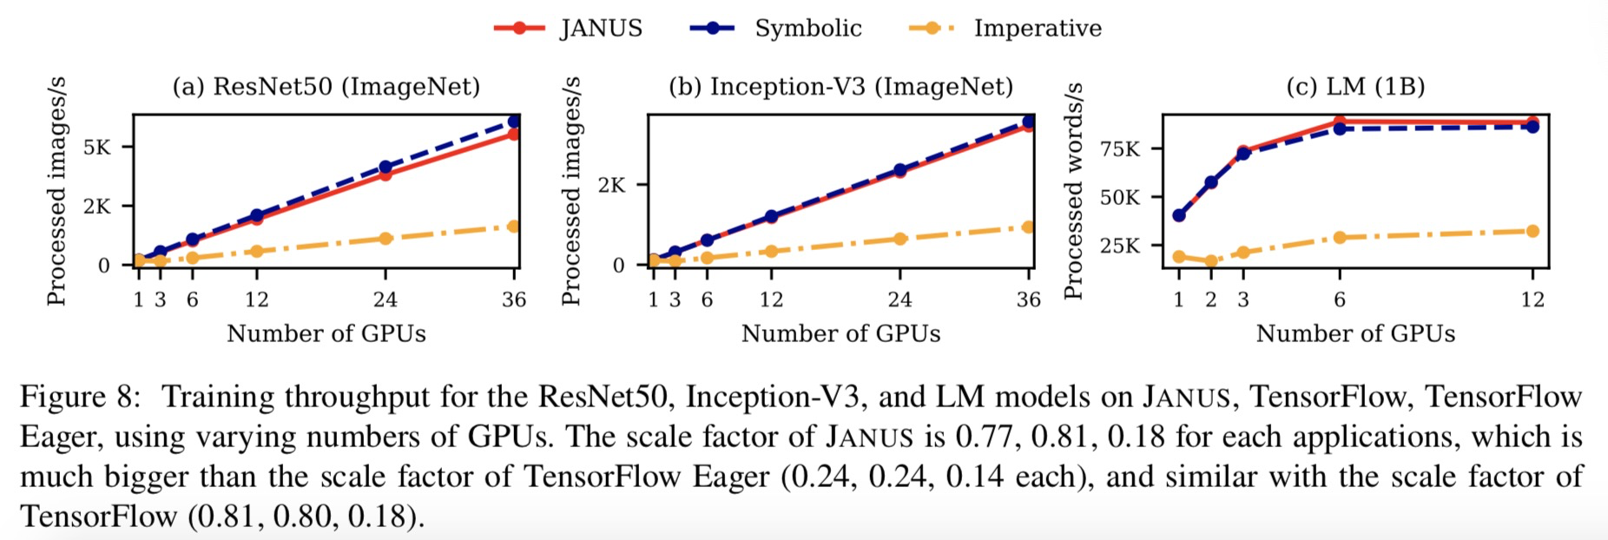
Evaluation
The conversion from Imperative to Symbolic Graph is successful.
Notes:
From this table, we could find the three NN models on JANUS can scale as well as on Tensorflow. But Tensorflow Eager cannot achieve such scalability.

Slide 19
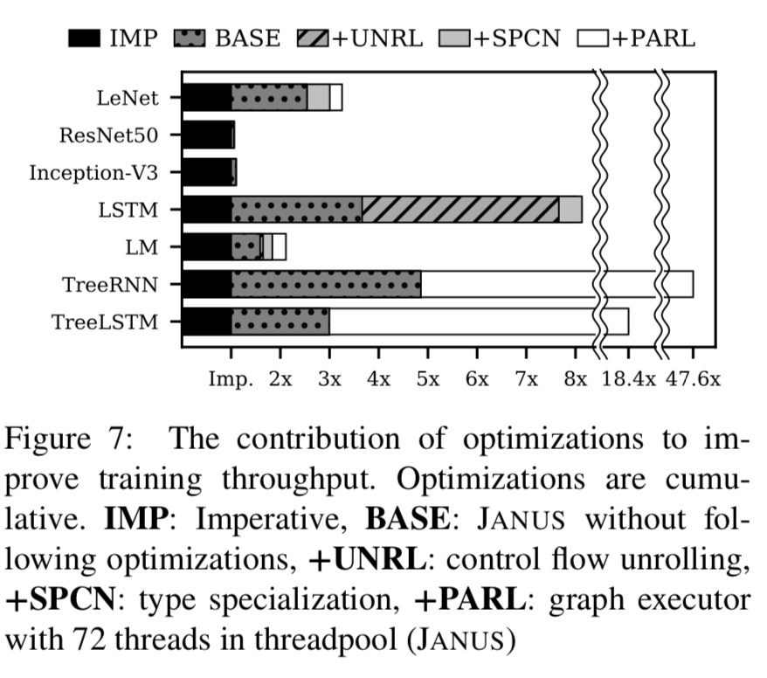
Evaluation
Notes:
From this table, the authors discussed about how much each optimization contributes to improve training throughput.

Slide 20
Comparison between Related works and JANUS
Tracing-based graph generation approaches
fail to capture dynamic semantics of the Python interpreter correctly
currently do not give any feedback about incorrectly-converted control flows to users
Approaches for a less-dynamic host language
lose the merit of supporting Python
Notes:
So in summary, we could find JANUS, unlike all other existing related works, can capture dynamic semantics of the Python interpreter correctly and give feedback about incorrectly-converted graph to users by raising assumption failure and adopting fallbacks.

Slide 21
Change of Tensorflow 2 and PyTorch 1.4
TF 2: better integrating with the Python runtime with Eager execution.
“TensorFlow 1.X requires users to manually stitch together an abstract syntax tree (the graph) by making tf.* API calls. It then requires users to manually compile the abstract syntax tree by passing a set of output tensors and input tensors to a session.run() call. By contrast, TensorFlow 2.0 executes eagerly (like Python normally does) and in 2.0, graphs and sessions should feel like implementation details.”
PyTorch 1.4: Distributed model parallel training
“builds the autograd graph during the forward pass and this graph is used to execute the backward pass”
Notes:
As a remark, the latest version of PyTorch has dealt with the problem mentioned in the paper by building a graph based on its imperative program. Also TF2 does not require users to manually compile AST anymore.

Slide 22
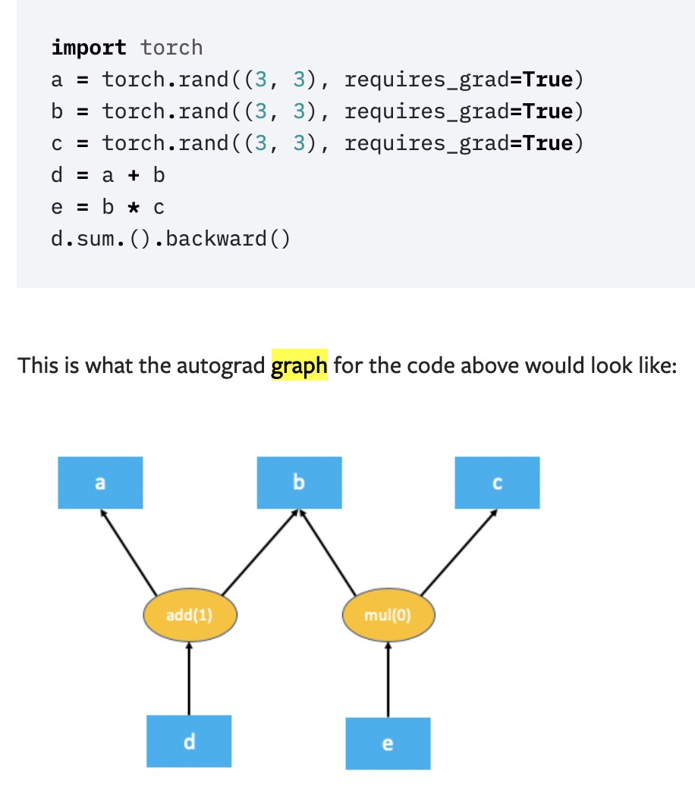
Change of Tensorflow 2 and PyTorch 1.4
TF 2: better integrating with the Python runtime with Eager execution.
“TensorFlow 1.X requires users to manually stitch together an abstract syntax tree (the graph) by making tf.* API calls. It then requires users to manually compile the abstract syntax tree by passing a set of output tensors and input tensors to a session.run() call. By contrast, TensorFlow 2.0 executes eagerly (like Python normally does) and in 2.0, graphs and sessions should feel like implementation details.”
PyTorch 1.4: Distributed model parallel training
“builds the autograd graph during the forward pass and this graph is used to execute the backward pass”
https://pytorch.org/docs/stable/notes/distributed_autograd.html

Slide 23
TASO: Optimizing Deep Learning Computation with Automatic Generation of Graph Substitutions

Slide 24
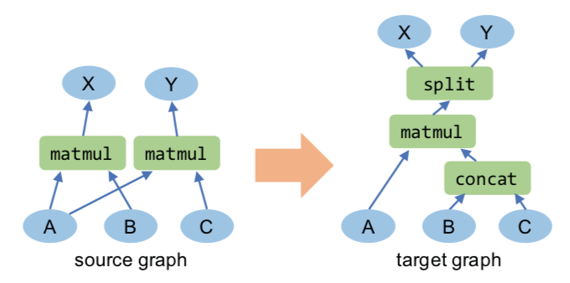
DNN Optimization with Graph Substitution
Notes:
We know that DNN frameworks represent a neural architecture as a computation graph. Existing DNN frameworks optimize the computation graph by applying graph substitution.
For example, we have a graph with matrix multiplication A dot B and A dot C, a valid substitution could concatenate B and C first, and then do the multiplication with A as a whole. We can see that these two graphs are functionally equivalent, …, but in some frameworks/ architecture, the second one might be faster.
So if we substitute all such source graph in our DNN model with the target graph, we can gain some extra performance.

Slide 25
DNN Optimization with Graph Substitution
Functionally equivalent
Faster with specific architecture
Notes:
We know that DNN frameworks represent a neural architecture as a computation graph. Existing DNN frameworks optimize the computation graph by applying graph substitution.
For example, we have a graph with matrix multiplication A dot B and A dot C, a valid substitution could concatenate B and C first, and then do the multiplication with A as a whole. We can see that these two graphs are functionally equivalent, …, but in some frameworks/ architecture, the second one might be faster.
So if we substitute all such source graph in our DNN model with the target graph, we can gain some extra performance.

Slide 26
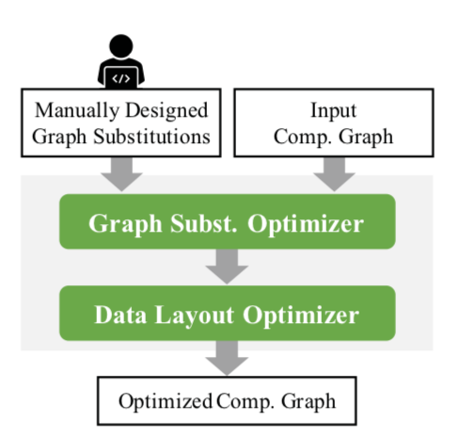
Problem: Expert Designed Graph Substitution
Notes:
In current framework, the graph substitution is manually designed by some experts. So there are several problems with expert designed graph substitution. The first one is the maintainability of hand-written substitutions. They require significant engineering effort. It is said there are 53K lines in Tensorflow for 155 substitutions. However, as deep learning keeps developing, new operator and new substitution strategies could be invented. So more engineering efforts are needed.
The second issue is with data layout. It means when the data got stored in memory, it is stored row by row or column by column, as shown in these two figures. How data should be stored in memory depends on the specific operator and underlying hardware. For the current graph optimization, graph substitution is done first and then data layout is optimized, so they are done in serial. But it could be better if this two optimization could be combined. For example, graph substitution A could outperform others if combined with data layout B.
The last issue is with regard to correctness, hand written substitution could have some bugs.

Slide 27
Problem: Expert Designed Graph Substitution
Maintainability
New operator
New substitution strategy
Notes:
In current framework, the graph substitution is manually designed by some experts. So there are several problems with expert designed graph substitution. The first one is the maintainability of hand-written substitutions. They require significant engineering effort. It is said there are 53K lines in Tensorflow for 155 substitutions. However, as deep learning keeps developing, new operator and new substitution strategies could be invented. So more engineering efforts are needed.
The second issue is with data layout. It means when the data got stored in memory, it is stored row by row or column by column, as shown in these two figures. How data should be stored in memory depends on the specific operator and underlying hardware. For the current graph optimization, graph substitution is done first and then data layout is optimized, so they are done in serial. But it could be better if this two optimization could be combined. For example, graph substitution A could outperform others if combined with data layout B.
The last issue is with regard to correctness, hand written substitution could have some bugs.

Slide 28

Problem: Expert Designed Graph Substitution
Maintainability
New operator
New substitution strategy
Notes:
In current framework, the graph substitution is manually designed by some experts. So there are several problems with expert designed graph substitution. The first one is the maintainability of hand-written substitutions. They require significant engineering effort. It is said there are 53K lines in Tensorflow for 155 substitutions. However, as deep learning keeps developing, new operator and new substitution strategies could be invented. So more engineering efforts are needed.
The second issue is with data layout. It means when the data got stored in memory, it is stored row by row or column by column, as shown in these two figures. How data should be stored in memory depends on the specific operator and underlying hardware. For the current graph optimization, graph substitution is done first and then data layout is optimized, so they are done in serial. But it could be better if this two optimization could be combined. For example, graph substitution A could outperform others if combined with data layout B.
The last issue is with regard to correctness, hand written substitution could have some bugs.

Slide 29
Problem: Expert Designed Graph Substitution
53K lines in TensorFlow
(155 substitions)
Maintainability
New operator
New substitution strategy
Notes:
In current framework, the graph substitution is manually designed by some experts. So there are several problems with expert designed graph substitution. The first one is the maintainability of hand-written substitutions. They require significant engineering effort. It is said there are 53K lines in Tensorflow for 155 substitutions. However, as deep learning keeps developing, new operator and new substitution strategies could be invented. So more engineering efforts are needed.
The second issue is with data layout. It means when the data got stored in memory, it is stored row by row or column by column, as shown in these two figures. How data should be stored in memory depends on the specific operator and underlying hardware. For the current graph optimization, graph substitution is done first and then data layout is optimized, so they are done in serial. But it could be better if this two optimization could be combined. For example, graph substitution A could outperform others if combined with data layout B.
The last issue is with regard to correctness, hand written substitution could have some bugs.

Slide 30
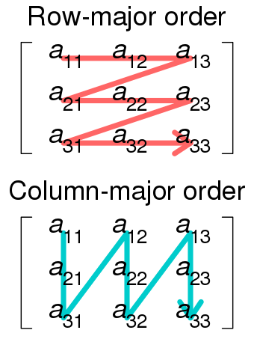
Problem: Expert Designed Graph Substitution
Maintainability
New operator
New substitution strategy
Data Layout
Row-major / Column-major
Depend on operator & hardware
Better if combined with graph subst.
Notes:
In current framework, the graph substitution is manually designed by some experts. So there are several problems with expert designed graph substitution. The first one is the maintainability of hand-written substitutions. They require significant engineering effort. It is said there are 53K lines in Tensorflow for 155 substitutions. However, as deep learning keeps developing, new operator and new substitution strategies could be invented. So more engineering efforts are needed.
The second issue is with data layout. It means when the data got stored in memory, it is stored row by row or column by column, as shown in these two figures. How data should be stored in memory depends on the specific operator and underlying hardware. For the current graph optimization, graph substitution is done first and then data layout is optimized, so they are done in serial. But it could be better if this two optimization could be combined. For example, graph substitution A could outperform others if combined with data layout B.
The last issue is with regard to correctness, hand written substitution could have some bugs.

Slide 31
Problem: Expert Designed Graph Substitution
BUG
Maintainability
New operator
New substitution strategy
Data Layout
Row-major / Column-major
Depend on operator & hardware
Better if combined with graph subst.
Correctness
Notes:
In current framework, the graph substitution is manually designed by some experts. So there are several problems with expert designed graph substitution. The first one is the maintainability of hand-written substitutions. They require significant engineering effort. It is said there are 53K lines in Tensorflow for 155 substitutions. However, as deep learning keeps developing, new operator and new substitution strategies could be invented. So more engineering efforts are needed.
The second issue is with data layout. It means when the data got stored in memory, it is stored row by row or column by column, as shown in these two figures. How data should be stored in memory depends on the specific operator and underlying hardware. For the current graph optimization, graph substitution is done first and then data layout is optimized, so they are done in serial. But it could be better if this two optimization could be combined. For example, graph substitution A could outperform others if combined with data layout B.
The last issue is with regard to correctness, hand written substitution could have some bugs.

Slide 32
Solution: TASO
Tensor Algebra SuperOptimizer
Maintainability
Optimized Data Layout
Correctness
Notes:
We know that DNN frameworks represent a neural architecture as a computation graph. To

Slide 33
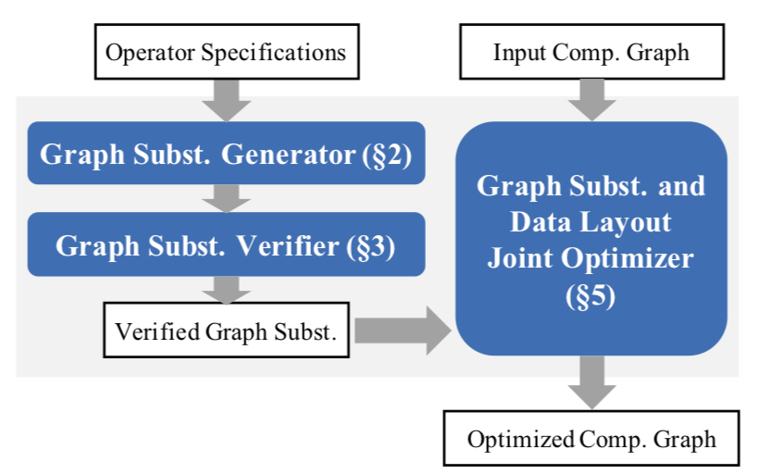
Solution: TASO
Tensor Algebra SuperOptimizer
Maintainability
Optimized Data Layout
Correctness
Automatically generate subst.
Notes:
with regard to these 3 issues, the author has presented TASO, which refers to…
The first feature is that TASO could automatically generate subst. The user only need to input some operator specifications, and the system could generate all possible subst.
The second feature is joint optimization, so with the generated graph substitutions and also the input DNN graph, graph substitutions and data layout are optimized together.
The last thing about correctness, so the system used a verifier to verify that the generated graph substitution is valid.

Slide 34
Solution: TASO
Tensor Algebra SuperOptimizer
Maintainability
Optimized Data Layout
Correctness
Automatically generate subst.
Joint optimization
Notes:
with regard to these 3 issues, the author has presented TASO, which refers to…
The first feature is that TASO could automatically generate subst. The user only need to input some operator specifications, and the system could generate all possible subst.
The second feature is joint optimization, so with the generated graph substitutions and also the input DNN graph, graph substitutions and data layout are optimized together.
The last thing about correctness, so the system used a verifier to verify that the generated graph substitution is valid.

Slide 35
Solution: TASO
Tensor Algebra SuperOptimizer
Maintainability
Optimized Data Layout
Correctness
Automatically generate subst.
Joint optimization
Formal verification
Notes:
with regard to these 3 issues, the author has presented TASO, which refers to…
The first feature is that TASO could automatically generate subst. The user only need to input some operator specifications, and the system could generate all possible subst.
The second feature is joint optimization, so with the generated graph substitutions and also the input DNN graph, graph substitutions and data layout are optimized together.
The last thing about correctness, so the system used a verifier to verify that the generated graph substitution is valid.

Slide 36
Solution: Graph Subst. Generator

Slide 37
Solution: Graph Subst. Generator
Brute Force
Arbitrary graph subst.
Notes:
First, let’s take a look at the generator. Note here the graph substitutions generated are independent of the input graph, so it is arbitrary graph, the algorithm they have used is kind of like brute force. They first enumerate all potential graphs, with DFS, up to some predefined threshold number of nodes. They have a list of operators supported and a pool of input tensors with different dimensions.
Then after a graph is generated, they are grouped by their fingerprint, the fingerprint is output on same input, the author claim if the two graphs have same output on same input, they are very likely to be functionally equal, so they are substitutions to each other.

Slide 38
Solution: Graph Subst. Generator
Brute Force
Empty
Enumerate potential graphs
DFS
up to threshold nodes
Op1(Input1, Input2)
Op1(Input2, Input3)
...
Op2(Input1, Input2)
Op2(Input2, Input3)
...
1st node
Op1(Output1, Input4)
Op1(Input3, Input4)
...
…...
2nd node
Notes:
First, let’s take a look at the generator. Note here the graph substitutions generated are independent of the input graph, so it is arbitrary graph, the algorithm they have used is kind of like brute force. They first enumerate all potential graphs, with DFS, up to some predefined threshold number of nodes. They have a list of operators supported and a pool of input tensors with different dimensions.
Then after a graph is generated, they are grouped by their fingerprint, the fingerprint is output on same input, the author claim if the two graphs have same output on same input, they are very likely to be functionally equal, so they are substitutions to each other.

Slide 39
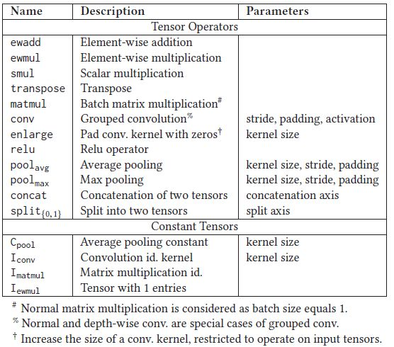
Solution: Graph Subst. Generator
Brute Force
Empty
Enumerate potential graphs
DFS
up to threshold nodes
Op1(Input1, Input2)
Op1(Input2, Input3)
...
Op2(Input1, Input2)
Op2(Input2, Input3)
...
1st node
Op1(Output1, Input4)
Op1(Input3, Input4)
...
…...
2nd node
Notes:
First, let’s take a look at the generator. Note here the graph substitutions generated are independent of the input graph, so it is arbitrary graph, the algorithm they have used is kind of like brute force. They first enumerate all potential graphs, with DFS, up to some predefined threshold number of nodes. They have a list of operators supported and a pool of input tensors with different dimensions.
Then after a graph is generated, they are grouped by their fingerprint, the fingerprint is output on same input, the author claim if the two graphs have same output on same input, they are very likely to be functionally equal, so they are substitutions to each other.

Slide 40
Solution: Graph Subst. Generator
Brute Force
Empty
Enumerate potential graphs
DFS
up to threshold nodes
Op1(Input1, Input2)
Op1(Input2, Input3)
...
Op2(Input1, Input2)
Op2(Input2, Input3)
...
1st node
Op1(Output1, Input4)
Op1(Input3, Input4)
...
…...
2nd node
Notes:
First, let’s take a look at the generator. Note here the graph substitutions generated are independent of the input graph, so it is arbitrary graph, the algorithm they have used is kind of like brute force. They first enumerate all potential graphs, with DFS, up to some predefined threshold number of nodes. They have a list of operators supported and a pool of input tensors with different dimensions.
Then after a graph is generated, they are grouped by their fingerprint, the fingerprint is output on same input, the author claim if the two graphs have same output on same input, they are very likely to be functionally equal, so they are substitutions to each other.

Slide 41
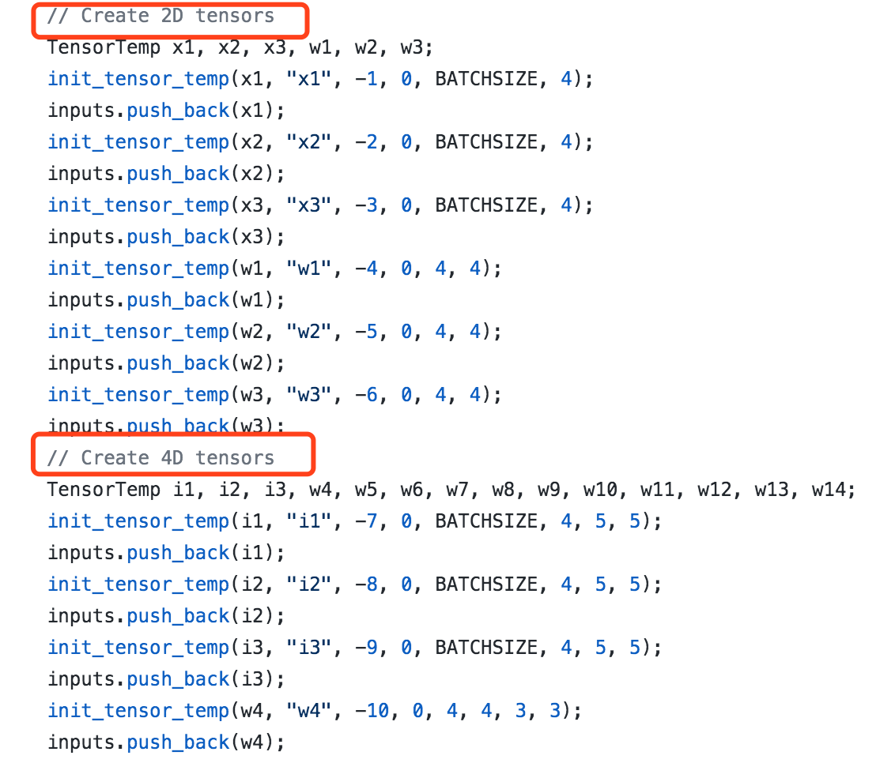
Solution: Graph Subst. Generator
Brute Force

Slide 42
Solution: Graph Subst. Generator
Brute Force
Enumerate potential graphs
DFS
up to threshold nodes
Calculate fingerprint
same fingerprint => functionally equal graph (very likely)
Fingerprint = Hash of output on same input
Notes:
First, let’s take a look at the generator. Note here the graph substitutions generated are independent of the input graph, so it is arbitrary graph, the algorithm they have used is kind of like brute force. They first enumerate all potential graphs, with DFS, up to some predefined threshold number of nodes. They have a list of operators supported and a pool of input tensors with different dimensions.
Then after a graph is generated, they are grouped by their fingerprint, the fingerprint is output on same input, the author claim if the two graphs have same output on same input, they are very likely to be functionally equal, so they are substitutions to each other.

Slide 43
Solution: Graph Subst. Generator
Brute Force
Enumerate potential graphs
DFS
up to threshold nodes
Calculate fingerprint
same fingerprint => functionally equal graph (very likely)
Testing graphs with identical fingerprint
More test cases
Notes:
First, let’s take a look at the generator. Note here the graph substitutions generated are independent of the input graph, so it is arbitrary graph, the algorithm they have used is kind of like brute force. They first enumerate all potential graphs, with DFS, up to some predefined threshold number of nodes. They have a list of operators supported and a pool of input tensors with different dimensions.
Then after a graph is generated, they are grouped by their fingerprint, the fingerprint is output on same input, the author claim if the two graphs have same output on same input, they are very likely to be functionally equal, so they are substitutions to each other.

Slide 44
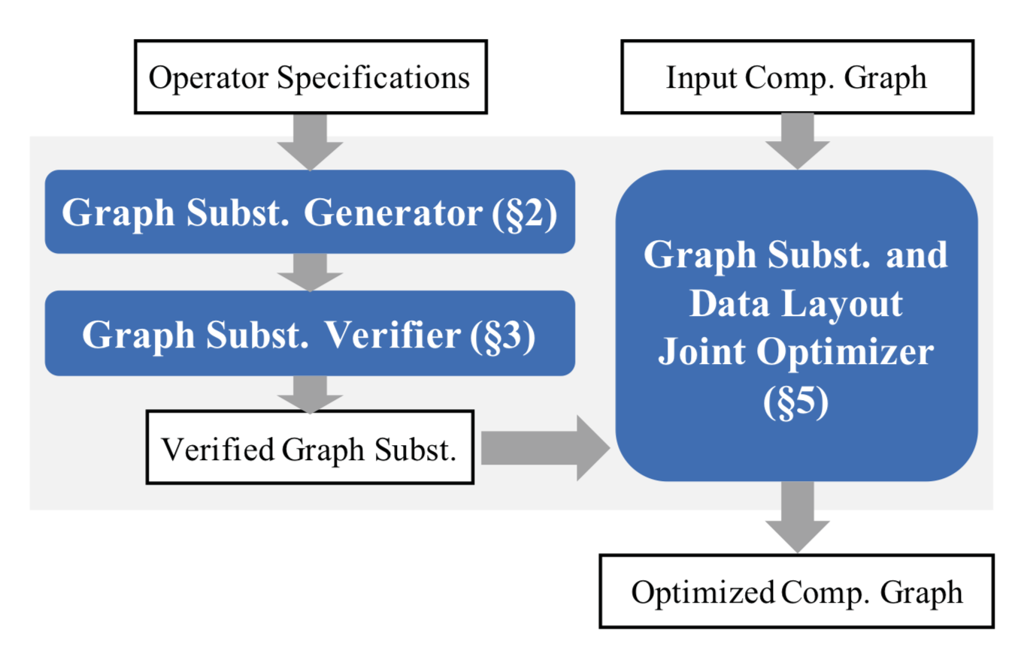
Solution: Graph Subst. Verifier

Slide 45
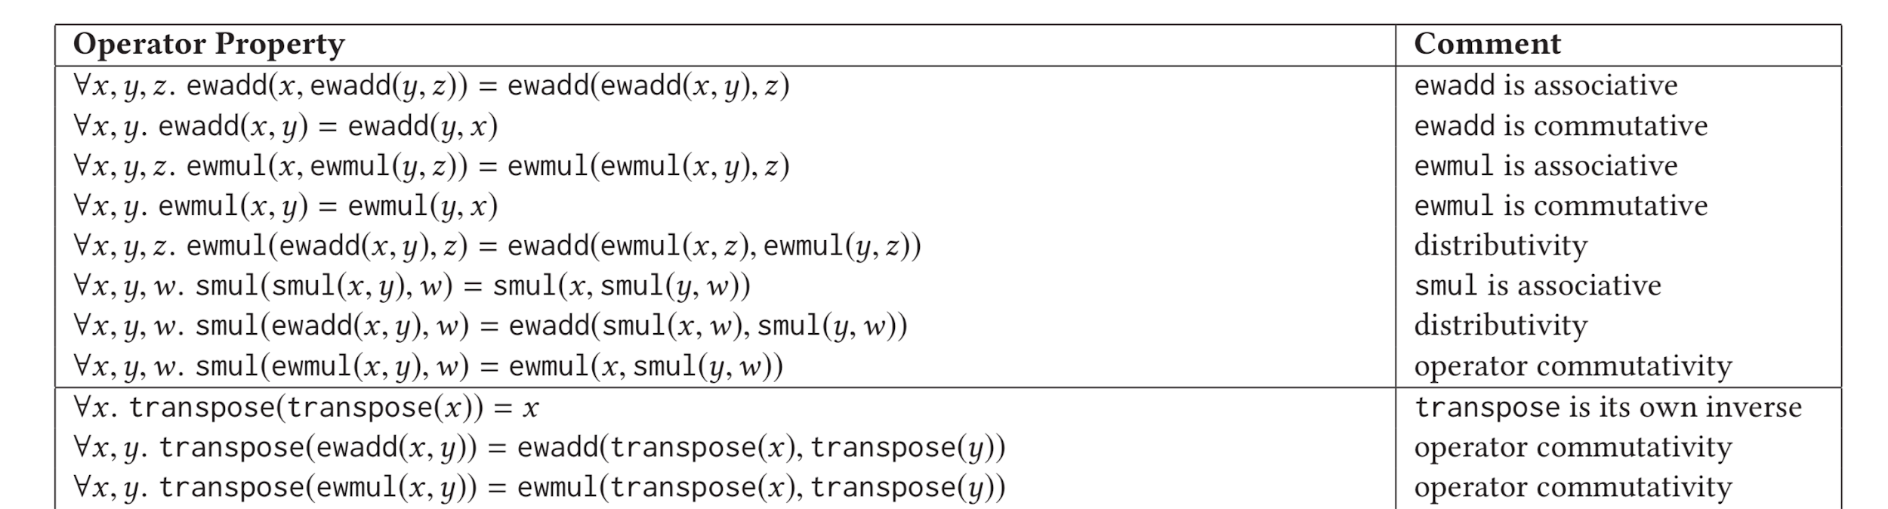
Solution: Graph Subst. Verifier
Further verify substitutions are valid
SMT model
Operator properties => first-order logic
A mature method to verify substitutes
User provides operator properties => Semi-automatic
Notes:
the verification step is semi-automatic

Slide 46
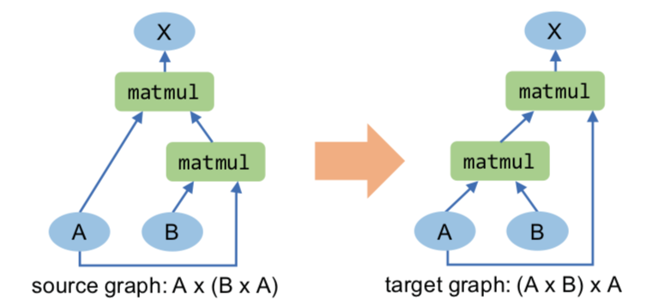
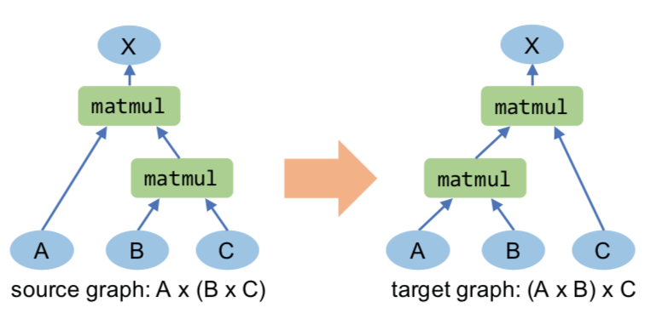
Solution: Pruning Redundant Substitutions
Input tensor renaming
Notes:
I think this part should be before verification to remove redundant substitutions. Remember that the generator has enumerated all possible graphs, but not all of them are necessary. So the author has proposed two methods to prune redundant substitutions.
Input tensor renaming
the more general one will be kept.
The second one is common subgraph. If there are common subgraph in a pair of substitutions, it could be replaced with a new node.

Slide 47
Solution: Pruning Redundant Substitutions
Input tensor renaming
Pruned
Notes:
I think this part should be before verification to remove redundant substitutions. Remember that the generator has enumerated all possible graphs, but not all of them are necessary. So the author has proposed two methods to prune redundant substitutions.
Input tensor renaming
the more general one will be kept.
The second one is common subgraph. If there are common subgraph in a pair of substitutions, it could be replaced with a new node.

Slide 48
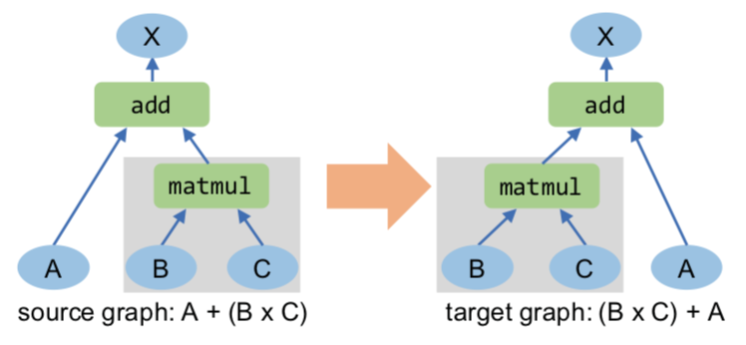
Solution: Pruning Redundant Substitutions
Input tensor renaming
Common subgraph
Notes:
I think this part should be before verification to remove redundant substitutions. Remember that the generator has enumerated all possible graphs, but not all of them are necessary. So the author has proposed two methods to prune redundant substitutions.
Input tensor renaming
the more general one will be kept.
The second one is common subgraph. If there are common subgraph in a pair of substitutions, it could be replaced with a new node.

Slide 49
Solution: Pruning Redundant Substitutions
Input tensor renaming
Common subgraph
D
D
Notes:
I think this part should be before verification to remove redundant substitutions. Remember that the generator has enumerated all possible graphs, but not all of them are necessary. So the author has proposed two methods to prune redundant substitutions.
Input tensor renaming
the more general one will be kept.
The second one is common subgraph. If there are common subgraph in a pair of substitutions, it could be replaced with a new node.

Slide 50
Solution: Joint Optimizer
Backtracking
Notes:
After the graphs are generated, pruned and verified, we finally got several pairs of verified graph substitutions, and can do the joint optimization.
They used backtracking algorithm. We maintained a priority search queue, initialized with the input graph.
We will evaluate the cost the graph. So I will talk about the cost model later.
It will be kept as a possible final optimization.
We will apply all possible substitutions and all possible layout to the graph, loop until the priority queue is empty.

Slide 51
Solution: Joint Optimizer
Backtracking
Priority Search Queue
Gin
S1
head
S2
...
Sn
Notes:
After the graphs are generated, pruned and verified, we finally got several pairs of verified graph substitutions, and can do the joint optimization.
They used backtracking algorithm. We maintained a priority search queue, initialized with the input graph.
We will evaluate the cost the graph. So I will talk about the cost model later.
It will be kept as a possible final optimization.
We will apply all possible substitutions and all possible layout to the graph, loop until the priority queue is empty.

Slide 52
Solution: Joint Optimizer
Backtracking
Priority Search Queue
Gin
S1
head
S2
...
Sn
Notes:
After the graphs are generated, pruned and verified, we finally got several pairs of verified graph substitutions, and can do the joint optimization.
They used backtracking algorithm. We maintained a priority search queue, initialized with the input graph.
We will evaluate the cost the graph. So I will talk about the cost model later.
It will be kept as a possible final optimization.
We will apply all possible substitutions and all possible layout to the graph, loop until the priority queue is empty.

Slide 53
Solution: Joint Optimizer
Backtracking
Priority Search Queue
Gin
S1
head
S2
...
Sn
Notes:
After the graphs are generated, pruned and verified, we finally got several pairs of verified graph substitutions, and can do the joint optimization.
They used backtracking algorithm. We maintained a priority search queue, initialized with the input graph.
We will evaluate the cost the graph. So I will talk about the cost model later.
It will be kept as a possible final optimization.
We will apply all possible substitutions and all possible layout to the graph, loop until the priority queue is empty.

Slide 54
Solution: Joint Optimizer
Backtracking
Priority Search Queue
Gin
S1
head
l1
l2
...
S2
...
Sn
Notes:
After the graphs are generated, pruned and verified, we finally got several pairs of verified graph substitutions, and can do the joint optimization.
They used backtracking algorithm. We maintained a priority search queue, initialized with the input graph.
We will evaluate the cost the graph. So I will talk about the cost model later.
It will be kept as a possible final optimization.
We will apply all possible substitutions and all possible layout to the graph, loop until the priority queue is empty.

Slide 55
Solution: Joint Optimizer
Backtracking
Priority Search Queue
Gin
l1
S1
head
l2
...
S2
...
Sn
Notes:
After the graphs are generated, pruned and verified, we finally got several pairs of verified graph substitutions, and can do the joint optimization.
They used backtracking algorithm. We maintained a priority search queue, initialized with the input graph.
We will evaluate the cost the graph. So I will talk about the cost model later.
It will be kept as a possible final optimization.
We will apply all possible substitutions and all possible layout to the graph, loop until the priority queue is empty.

Slide 56
Solution: Joint Optimizer
Backtracking
Priority Search Queue
Gin
G1
l1
S1
head
l2
...
S2
...
Sn
Notes:
After the graphs are generated, pruned and verified, we finally got several pairs of verified graph substitutions, and can do the joint optimization.
They used backtracking algorithm. We maintained a priority search queue, initialized with the input graph.
We will evaluate the cost the graph. So I will talk about the cost model later.
It will be kept as a possible final optimization.
We will apply all possible substitutions and all possible layout to the graph, loop until the priority queue is empty.

Slide 57
Solution: Joint Optimizer
Backtracking
Priority Search Queue
Gin
S1
head
l2
...
S2
thrown
...
N
Optimal?
G1
valid?
Cost Model
Sn
Y
<=α optimal cost?
Notes:
After the graphs are generated, pruned and verified, we finally got several pairs of verified graph substitutions, and can do the joint optimization.
They used backtracking algorithm. We maintained a priority search queue, initialized with the input graph.
We will evaluate the cost the graph. So I will talk about the cost model later.
It will be kept as a possible final optimization.
We will apply all possible substitutions and all possible layout to the graph, loop until the priority queue is empty.

Slide 58
Solution: Joint Optimizer
Backtracking
Priority Search Queue
Gin
S1
G1
head
l2
...
S2
thrown
...
N
Optimal?
valid?
Cost Model
Sn
Y
<=α optimal cost?
Y
Notes:
After the graphs are generated, pruned and verified, we finally got several pairs of verified graph substitutions, and can do the joint optimization.
They used backtracking algorithm. We maintained a priority search queue, initialized with the input graph.
We will evaluate the cost the graph. So I will talk about the cost model later.
It will be kept as a possible final optimization.
We will apply all possible substitutions and all possible layout to the graph, loop until the priority queue is empty.

Slide 59
Solution: Joint Optimizer
Backtracking
Priority Search Queue
Gin
l2
S1
G1
head
...
S2
thrown
...
N
Optimal?
valid?
Cost Model
Sn
Y
<=α optimal cost?
Y
Notes:
After the graphs are generated, pruned and verified, we finally got several pairs of verified graph substitutions, and can do the joint optimization.
They used backtracking algorithm. We maintained a priority search queue, initialized with the input graph.
We will evaluate the cost the graph. So I will talk about the cost model later.
It will be kept as a possible final optimization.
We will apply all possible substitutions and all possible layout to the graph, loop until the priority queue is empty.

Slide 60
Solution: Joint Optimizer
Backtracking
Priority Search Queue
Gin
l2
S1
G1
head
...
S2
thrown
...
N
Optimal?
valid?
Cost Model
Sn
Y
<=α optimal cost?
Y
Notes:
After the graphs are generated, pruned and verified, we finally got several pairs of verified graph substitutions, and can do the joint optimization.
They used backtracking algorithm. We maintained a priority search queue, initialized with the input graph.
We will evaluate the cost the graph. So I will talk about the cost model later.
It will be kept as a possible final optimization.
We will apply all possible substitutions and all possible layout to the graph, loop until the priority queue is empty.

Slide 61
Solution: Cost Model
Measure the execution time of an operator
for each configuration (e.g. stride & padding for conv)
for each data layout
Cost(Graph) = sum of individual operator execution time

Slide 62
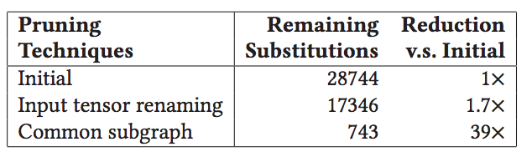
Evaluation: generate and verify
Automatically generate and verify
graph subst. with up to 4 nodes
5 minutes
Graph subst. with more than 5 nodes
Cannot fit in memory => Distributed generator needed!

Slide 63
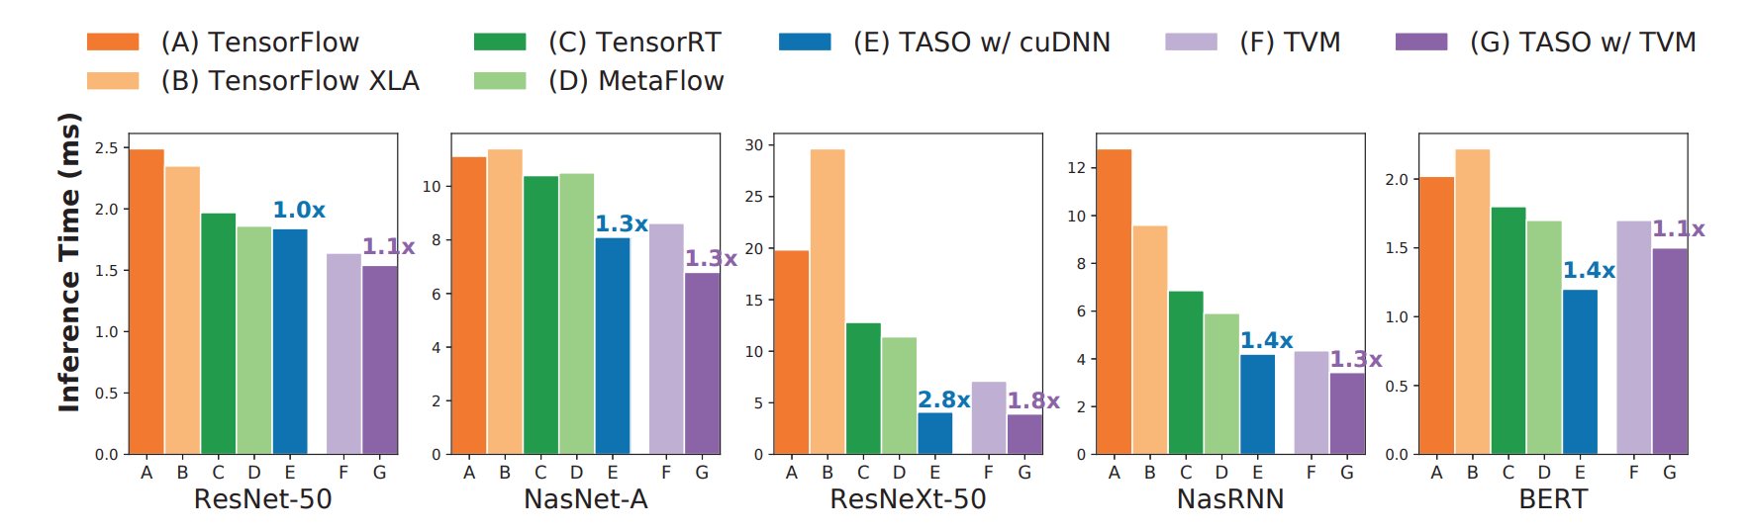
Evaluation: end-to-end inference
1.3x-2.8x speedup w/ cuDNN, 1.1x to 1.8x speedup w/ TVM
ResNet-50 is heavily optimized by existing DNN frameworks

Slide 64
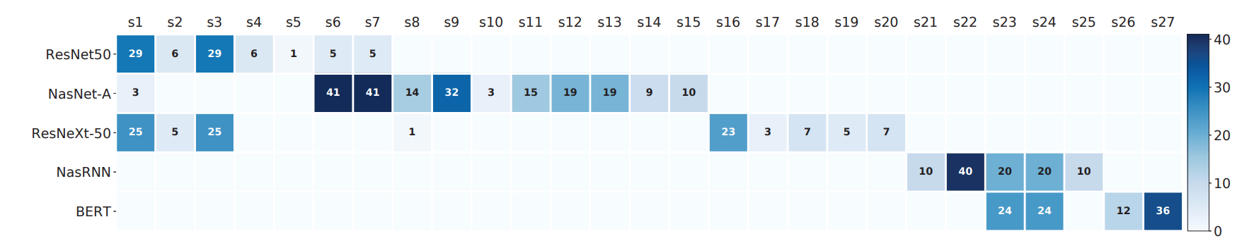
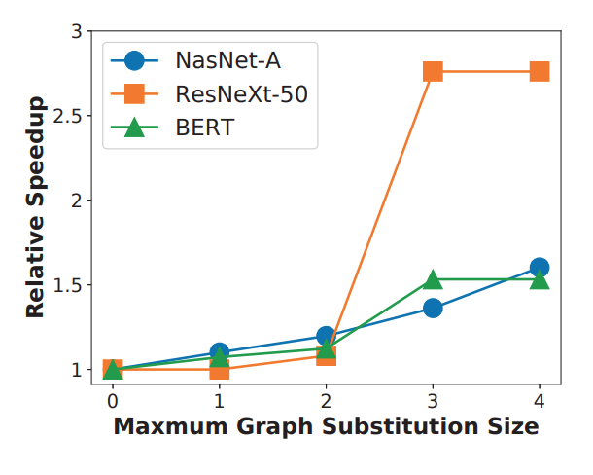
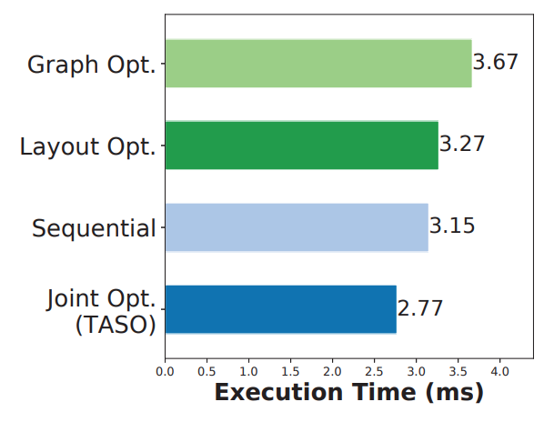
Evaluation: used substitutions, scaleup & joint opt.
Notes:
heat map counted, how many substitutions have been used for each method, we can see that it is quite distributed and there are not a one-size-fits-all solution.
It is quite weird to have performance drop for this green line BERT, but the author say nothing about it.

Slide 65
Related Work
Automated DNN code generation
TVM: optimized code for hardware backends (operator level)
TASO: optimized at a higher graph level
Automated DNN parallelization
ColocRL/ FlexFlow: assumed fixed computation graph
TASO: can support parallelization techniques
Data layout optimization
TASO: joint optimization
Notes:
mature method to verify

Slide 66
Limitation
Reliance on user provided operator properties
verification
Scalability
graphs with more than 4 nodes
distributed generator / more efficient algorithm
Combine graph-level and operator-level optimizations
Notes:
mature method to verify

Slide 67
Discussion
JANUS
How JANUS react when assumption fails?
How JANUS deal with Dynamic Type?
Does JANUS mutate globally accessible states during graph execution or at the end of execution?
TASO
Cost Model: factors to consider other than execution time?
Execution time independent of the size of input tensor?
What is the relationship between JANUS and TASO?
Notes:
mature method to verify

